Slide 1

Analyzing Swiggy :
Bangalore Delivery Outlet
By: Soumyadip Tikader
November 2022

Slide 2
Table of Contents
Index No. | Title | Page No
1 | Introduction | 3
2 | Objective | 4
3 | Data Sharing Agreement | 5
4 | Data Overview | 6
5 | Architecture | 7
6 | KPI | 8
7 | Insights | 9
8 | Dashboard | 10
9 | Q & A | 11

Slide 3
INTRODUCTION
The online food ordering market includes food prepared by restaurants, prepared by independent people, and groceries ordered online and then picked up or delivered. The first online food ordering service, Worldwide Waiter (now known as Waiter.com), was founded in 1995. Online food ordering is the process of ordering food from a website or other application. The product can be either ready-to-eat food or food that has not been specially prepared for direct consumption.
In the world of rising new technology and innovation, the Food industry is advancing with the role of Data Science and Analytics. Data analysis can help them to understand their business in a quite different manner and helps to improve the quality of the service by identifying the weak areas of the business. This study demonstrates how different analysis help to make better business decisions and help analyze customer trends and satisfaction, which can lead to new and better products and services. Different analyses were performed such as Exploratory Data Analysis and Descriptive Analysis on a variety of use cases to get the key insights from this data based on which business decisions will be taken.

Slide 4



OBJECTIVE
To get insights into the restaurant comparison of different areas in Bangalore (India). The insight includes the top restaurants by rating, cost of two persons and many more parameters. It also provides us with the leverage to select the top restaurant area-wise, rating-wise, etc.
Get Insights
Extract-Transform-Load Data
Visualize the gathered Insights

Slide 5
Data Sharing Agreement
File Name: Swiggy Bangalore Outlet Details.csv
Number of Rows: 119
Number of columns: 5
Column Name: Shop_Name, Cuisine, Location, Rating and Cost_for_Two
Column Data Type: string, float and int
5

Slide 6
DATA OVERVIEW
The Data includes a single .csv file with all examples.
The Number of Instances: 119 for Swiggy Bangalore Outlet Details.csv
Number of attributes – 5 attributes
6

Slide 7
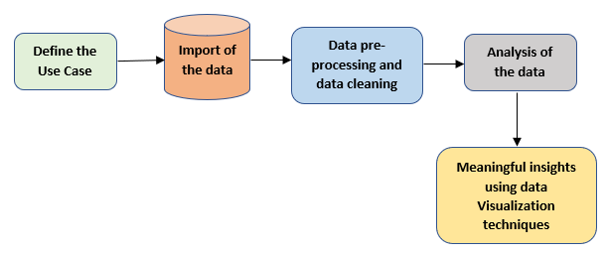
ARCHITECTURE
7

Slide 8
Key Performance Indicators (KPIs)
Key indicators displaying a summary of the restaurant name with cuisine, and information based on various parameters –
Shop_Name: Name of restaurants in Bangalore.
Cuisine: Name of cuisine corresponding to the given shop.
Location: Location of the restaurant in Bangalore.
Rating: Rating of the shop (Between 1 to 5).
Cost_for_Two : Cost of food of 2 people in the respective restaurant.

Slide 9
INSIGHTS
There is a total of 115 Restaurants in Bangalore with 79 different cuisines in 4 different locations.
Koramangala has the most no. of restaurants i.e., 64, BTM has 35 restaurants, HSR has 18 restaurants and Jayanagar has only 1 restaurant.
HSR area restaurants are more expensive in terms of average cost than restaurants in other areas.
One of the Best restaurants in Bangalore is Khichdi Experiment whose rating is 4.8, cost for 2 is about ₹200 and it is in Koramangala area. It offers ‘Healthy Food’, ‘Home Food’ and ‘Indian’ cuisines.
Punjabi Rasoi is the costliest restaurant in Bangalore, costing two as ₹800. The restaurant is located in HSR and only offers ‘North Indian’ cuisine.
The average rating of all restaurants in Bangalore is 4.09

Slide 10
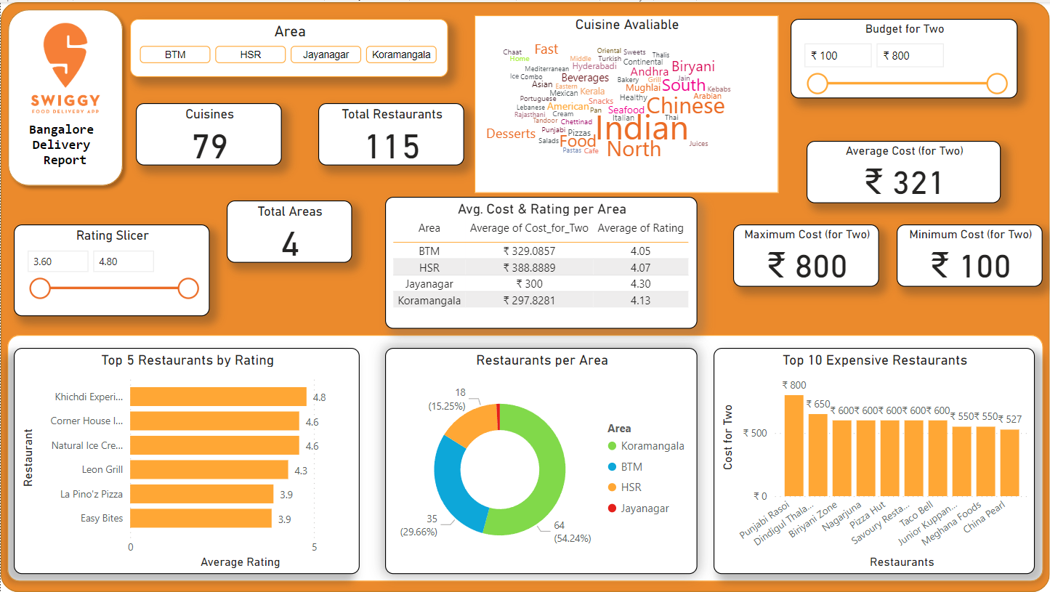
DASHBOARD OVERVIEW
10

Slide 11
Q & A
1. What’s the source of the Dataset?
Ans.- The dataset is publicly available for research purposes. Dataset link.
2. What types of Data are present?
Ans.- The dataset consists of numerical and categorical data.
3. How do we perform data pre-processing?
Ans.- In this project data pre-processing is done using DAX in Power BI after loading the dataset.
4. What are the different ways of getting insights from data?
Ans.- We can get insights in multiple ways like performing Exploratory Data Analysis, making visualizations, and creating dashboards.
11

Slide 12
THANK YOU

